Slide 1
Notes:
This powerpoint is designed as a classroom introduction to KS1 or 2 English activities using paper dolls from the University Library, Cambridge.
Printable reproductions of the dolls, and suggestions for these follow-up activities can be found in separate documents on the Library website.
This presentation introduces children to looking closely at primary sources and using evidence to understand the past. It encourages children to ask perceptive questions, think critically and weigh evidence. The key historical questions addressed are:
What are these objects?
How old are they?
How were they used?
Where were they made?
Can we use other evidence, from adverts and pictures, to find out more?
What can these toys tell us about how children in the past played?
As well as being used in conjunction with the suggested English activities, these paper dolls may be useful resources for studying toys through time, or Victorian history.

Slide 2
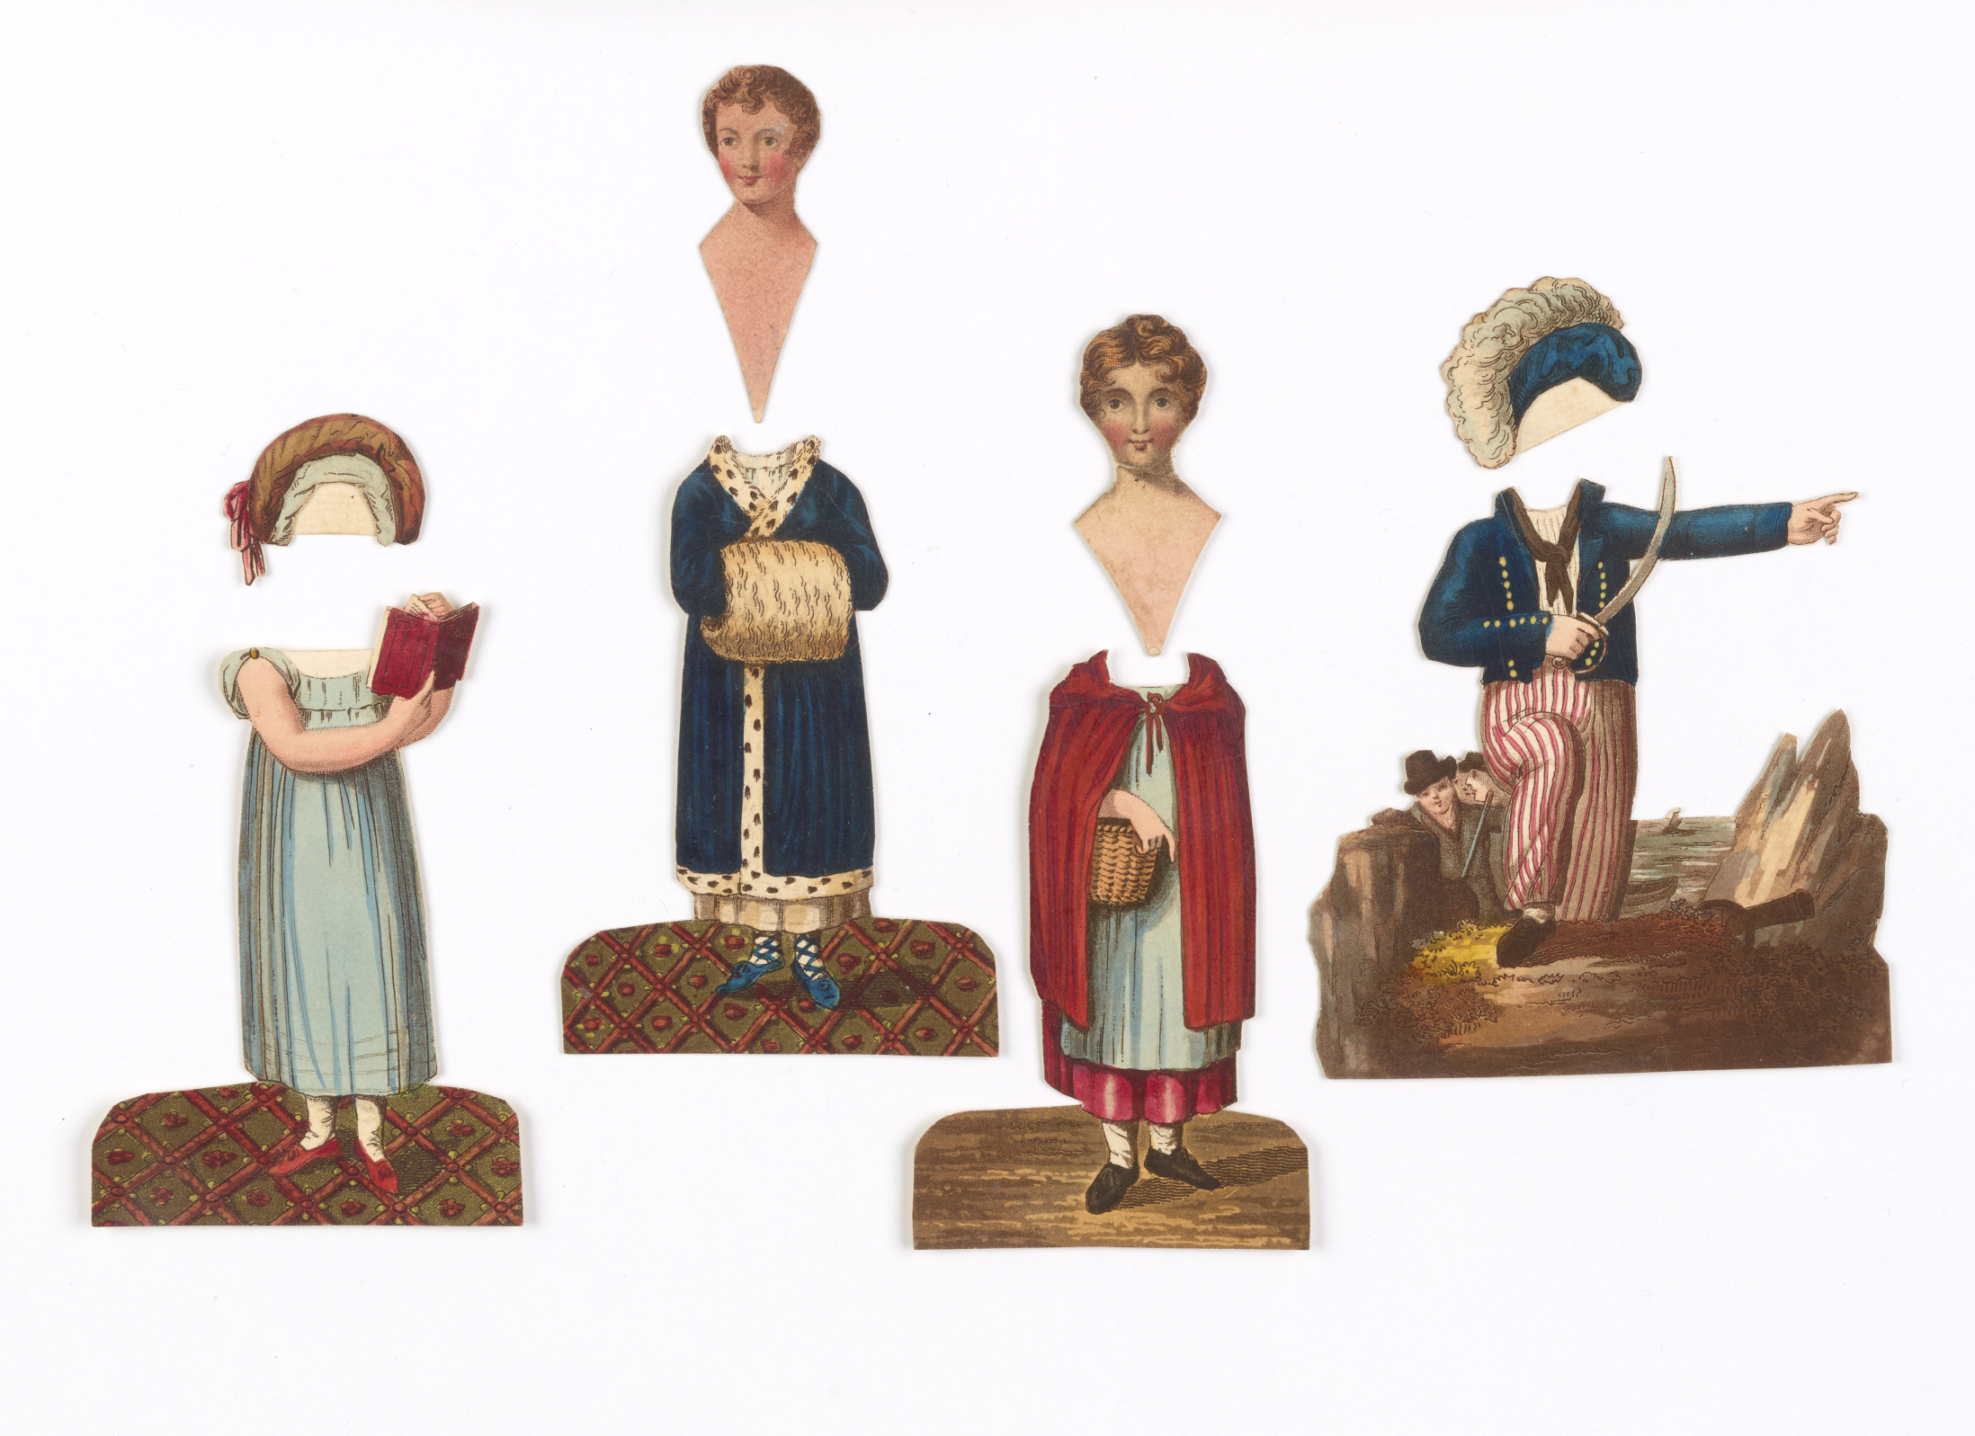
Notes:
What do you see? What do you think they are?
These are paper dolls. They are unusual because they have one head which is moved between the different costumes. Usually paper dolls have a body and different clothes to put on top. On these paper dolls there is a little paper pocket on the back of each costume so that the neck can slot into place.
What do you think they are made of?
They are made of thick paper, and were printed on a machine, but coloured in by hand.
How old do you think they might be?
The colours are still bright and paper is fragile, but they don’t look like they have been used too much. The clothes are old fashioned.
Do children still play with paper dolls today?

Slide 3
Notes:
This is a whole set of the paper dolls. They were sold in a paper pocket with a miniature storybook.
This story is called ‘Lauretta, the little Savoyard.’ Savoyard means someone from Savoy, which is a place between France, Italy and Switzerland.
The little storybooks told the story of a character who left their families, went through difficult experiences and finally found their parents again.
The different costumes show the different jobs Lauretta had on her journey. Can you find her as a goatherd? And as a dancer with a tambourine?
Looking at these paper dolls, do you get any more clues about how old they might be?
We have to be detectives when we are investigating old objects, and look very carefully for clues and evidence.
We could think about what they are made of. If they were made of plastic, we would know that they were not more than 150 years old.
But these dolls are made of paper, which has been around for hundreds of years, and so has mechanical printing.
We could look closely at the clothes the people are wearing, and compare them with clothes people wore in the past…

Slide 4
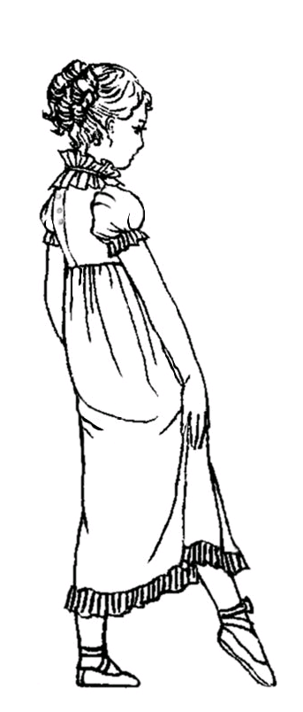
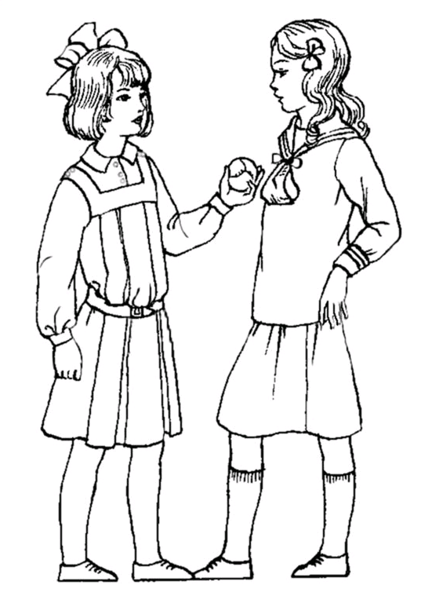
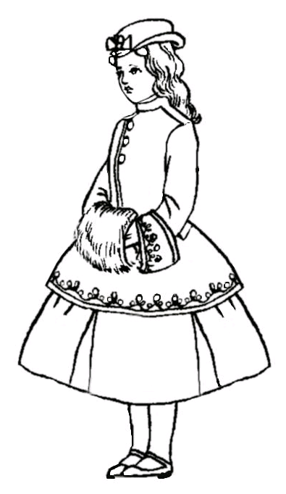
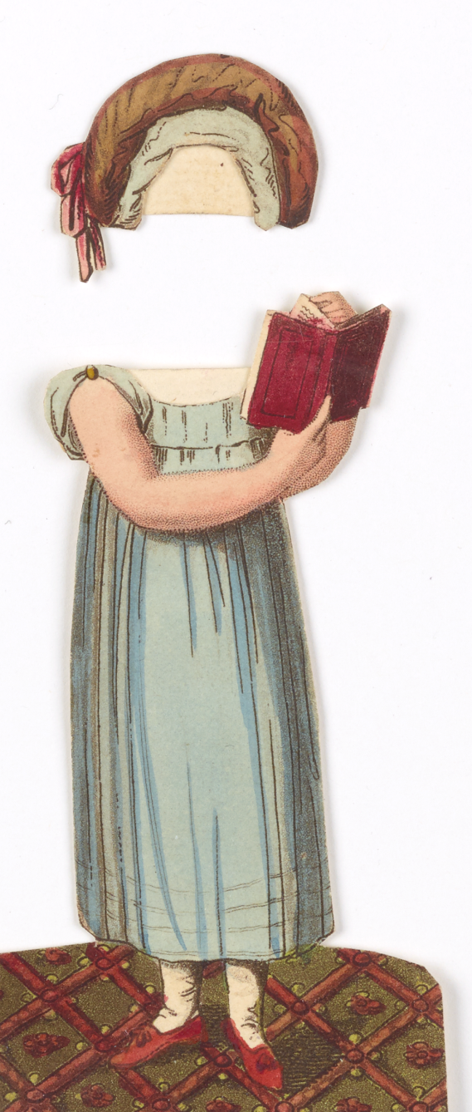
1805
1865
1910
Notes:
Which of these costumes looks most like the blue dress here?
Look at the shape of the dress. How long is it? Where is the waistline? What shape are the sleeves?
It looks most like the first dress, from 1805.
But is there a problem with using the clothes as evidence for a date?
What if the story was set in the past –today, you might read a story about a child living in Victorian times.
Where else could we look for evidence of a date?
Line drawings © Pauline Thomas, www.fashion-era.com

Slide 5
Notes:
An easier way to find a date is to look carefully to see if one is written on the toy.
Most toys don’t have a date on them, but books almost always have a date printed in the front to show when they were made. Luckily, our paper dolls come with a mini book.
Can you see when this book was published?
1813. How many years ago was that?
So these paper dolls are over 200 years old. Is that older than you guessed?
They still look bright and quite new – because they have been cared for in the University Library in Cambridge. They were probably not played with very much or maybe not at all, before they came into the Library’s collection.
If we want to find out more about old toys, one way is to look at the toys themselves. But often toys get played with a lot and they get damaged and thrown away.
Do you have any toys that belonged to your grandparents? Do you have any toys that are over 200 years old?
As well as looking at old toys, we can learn more about the places that made them. How could we do that?
Looking carefully at this book, can you see where the dolls and books were printed?
In London, at the ‘Temple of Fancy, and Juvenile Museum, Rathbone Place.’
How could we find out more about this mysterious-sounding place?

Slide 6
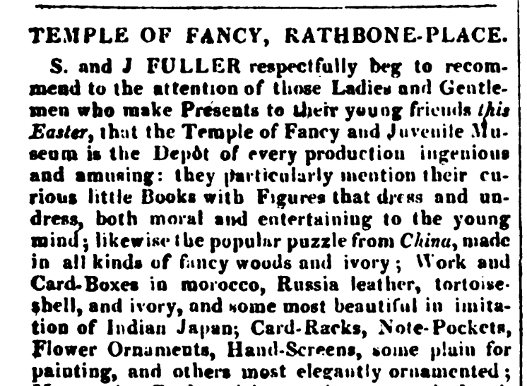
Notes:
Another book from 1817 has a list of lots of different shops. It’s like a Yellow Pages.
We can find this advert from the ‘Temple of Fancy’, where the paper dolls were made – can you see what they call the dolls?
(‘Curious little books with figures that dress and undress’.)
Can you find three other things that they sell?
Are these the sort of things you would like to be given as a present?
What are your favourite toys? Could they have existed 200 years ago?
From: The Repository of Arts, Literature, Fashions, Manufactures, &c, Volume 3, Ackermann, 1817. Digitised by Google.

Slide 7
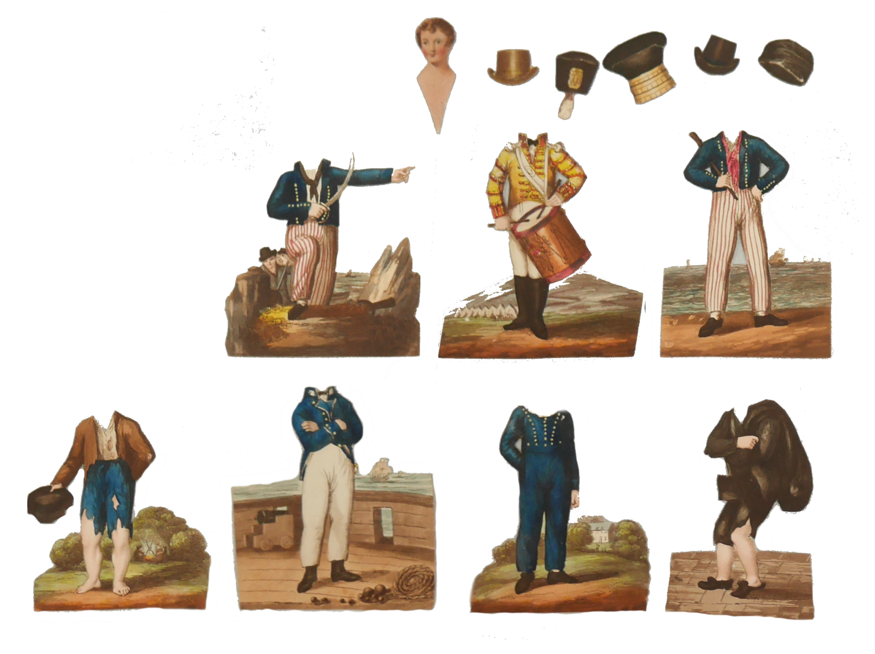
Notes:
Let’s look at another of the paper dolls.
This is the story of Little Henry.
Looking at the costumes he wears, what jobs do you think Henry does in his story? He has quite an adventure.
How do you think children in the past played with these paper toys?

Slide 8
Notes:
Remember that each set of dolls came with a book.
Maybe children would read the story and swap the heads over each time the main character changed their role.
Maybe a grown up read to them while they played with the paper dolls.
Maybe they ignored the book and made up their own stories with the dolls.
Which would you do?

Slide 9
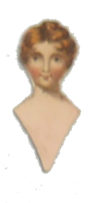
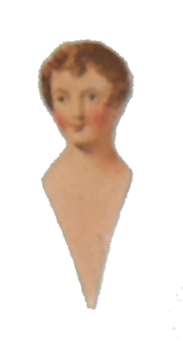
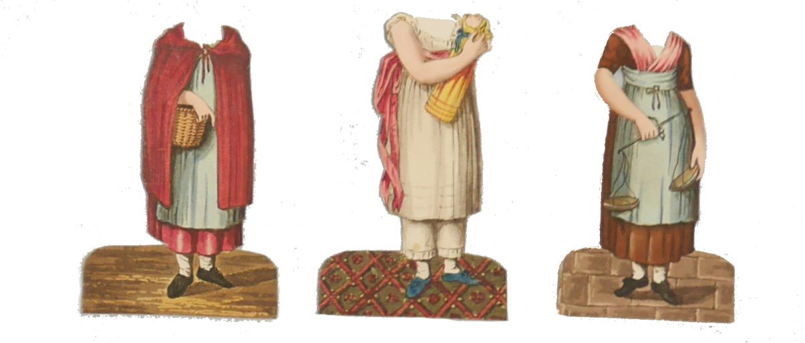
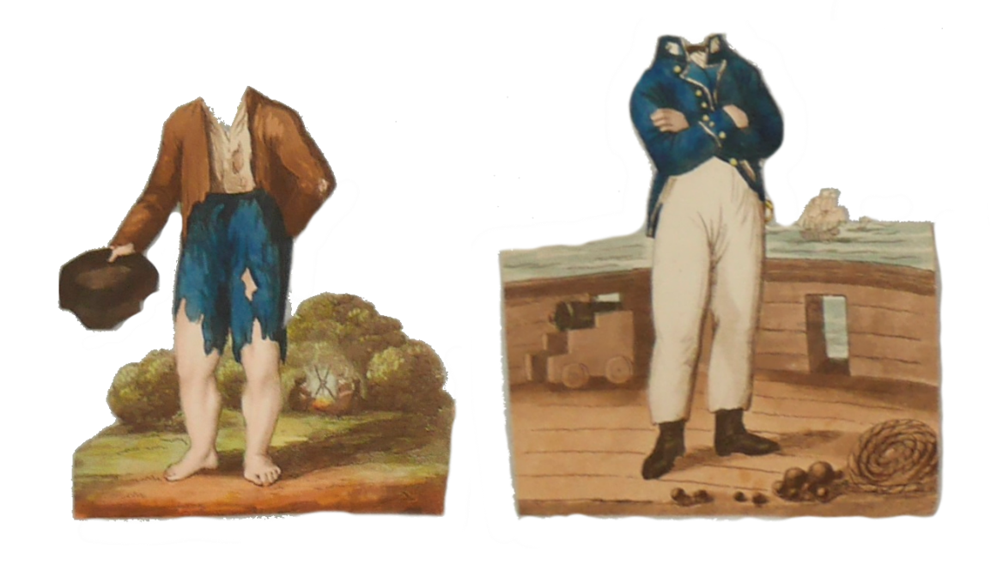
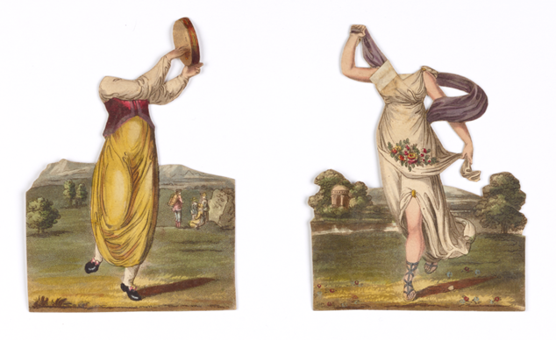
Notes:
The heads of the boys and girls in the three sets here look very similar. They all have short hair.
Maybe children who owned more than one set of dolls would mix up the sets, swap the heads around and make up their own stories.
Now we are going to look more closely at some copies of these toys and think more about the stories they could tell.
Move to classroom activities with print-outs of the dolls.

